Slide 1

Software Engineering
Lecture 9: Software Testing

Slide 2
What is Software Testing?
Testing is intended to show that a program does what it is intended to do
Discover program defects before it is put into use.
To achieve this, you execute the program with artificial data
You check the results of the test run for errors, anomalies or information about program's non-functional attributes.

Slide 3
Why Testing and Analysis?
Software is never correct no matter which developing technique is used
Any software must be verified.
Software testing and analysis are:
important to control the quality of the product (and of the process)
very (often too) expensive
difficult and stimulating

Slide 4
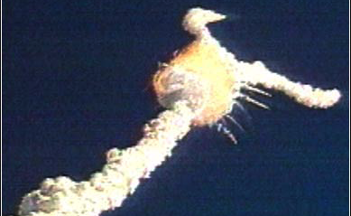
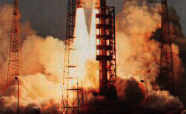
Ariane 5
Development took 10 years & $7 billion
On June 4, 1996, the flight of the Ariane 5 launcher ended in a failure
Only about 37 seconds after initiation of the flight sequence, at an altitude of about 3,700 m, the launcher veered off its flight path, broke up and exploded
“Fixed” Ariane 5 – currently being used
Notes:
It took the European Space Agency 10 years and $7 billion to produce Ariane 5, a giant rocket capable of hurling a pair of three-ton satellites into orbit with each launch and intended to give Europe overwhelming supremacy in the commercial space business. All it took to explode that rocket less than a minute into its maiden ...

Slide 5
Ariane 5 – Root Cause
Source: ARIANE 5 Flight 501 Failure, Report by the Inquiry Board
A program segment for converting a floating point number to a signed 16 bit integer was executed with an input data value of a 64-bit number.
The segment was written for Ariane 4 and the conversion was left unprotected, because it was thought that Ariane 4 will never attain such a value.
The subsystem containing this segment was reused for Ariane 5 as it had been successfully used over years for Ariane 4
This run time error (out of range, overflow), which arose in both the active and the backup computers at about the same time, was detected and both computers shut themselves down.
This resulted in the total loss of altitude control. This breakup was detected by an on-board monitor which ignited the explosive charges to destroy the vehicle in the air.
Ironically, this program segment was not required by Ariane 5
Notes:
Error: total loss of “attitude” > Altitude

Slide 6
Ariane 5 – Lessons Learned
Adequate exception handling and redundancy strategies (real function of a backup system, degraded modes?)
Clear, complete, documented specifications (e.g., preconditions, post-conditions)
But perhaps more importantly: usage-based testing (based on operational profiles), in this case actual Ariane 5 trajectories
Note this was not a complex, computing problem, but a deficiency of the software engineering practices in place …

Slide 7
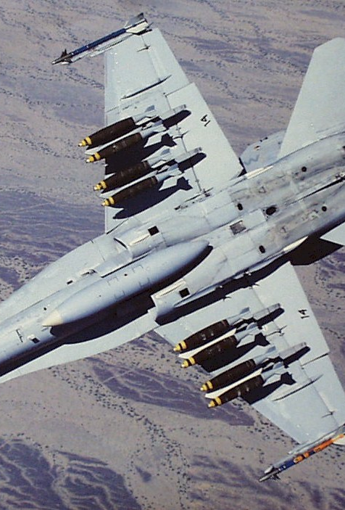
F-18 crash
An F-18 crashed because of a missing exception condition:
An if ... then ... block without the else clause that was thought could not possibly arise.
In simulation, an F-16 program bug caused the virtual plane to flip over whenever it crossed the equator, as a result of a missing minus sign to indicate south latitude.
Notes:
flip over >> capsize

Slide 8
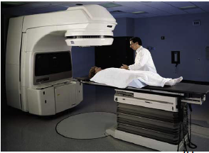
Fatal Therac-25 Radiation
In 1986, a man in Texas received between 16,500-25,000 radiations in less than 10 sec, over an area of about 1 cm.
He lost his left arm, and died of complications 5 months later.

Slide 9
Therac 25
Incident: A patient passed away
Failure: The device applied higher frequency of radiations than what was safe. Safety range: [1…10,000 Hz]
Fault: The software controller of the device did not have a conditional block (if …. else statements) to perform range checking on the frequency of the radiation to be applied.
Errors:
1. The SW developer of the device controller system had forgotten to include a range checking conditional block on the frequency of the radiation to be applied.
2. The device operator was NOT supposed to enter anything outside [1…10,000 Hz] range.

Slide 10
Errors
Errors are part of our daily life
Humans make errors in their thoughts, actions, and in the products that might result from their actions
Errors occur wherever humans are involved in taking actions and making decisions
These fundamental facts of human existence make testing an essential activity

Slide 11
Faults and Failures
Fault (bug):
Programming or design error whereby the delivered system does not conform to specification (e.g., coding error, protocol error)
Failure:
Software does not deliver the service expected by the user (e.g., mistake in requirements, confusing user interface)

Slide 12
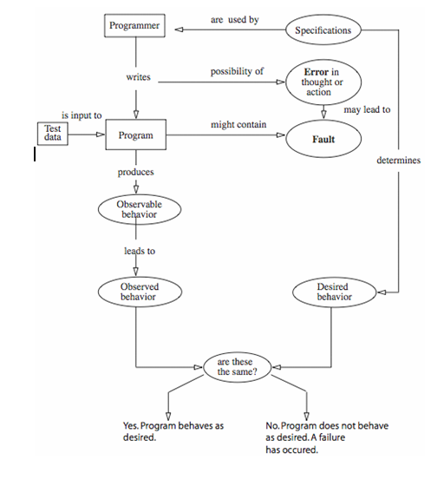

Software Error, Fault, Failure
If not
removed
Defect

Slide 13
Terminology
Fault avoidance
Build systems with the objective of creating fault-‐free (bug-‐free) software.
Fault detection (testing and verification)
Detect faults (bugs) before the system is put into operation or when discovered after release.
Fault tolerance
Build systems that continue to operate when problems (bugs, overloads, bad data, etc.) occur.

Slide 14
Test Cases
A test case, in software engineering, is a set of conditions or variables under which a tester will determine whether an application, software system or one of its features is working as it was originally established for it to do.
“A set of test inputs, execution conditions, and expected results developed for a particular objective, such as to exercise a particular program path or to verify compliance with a specific requirement.” (IEEE)
Developing and writing Test Casesis one of the major and most important activity in the entire testing cycle of an application

Slide 15
How to write good test cases
When you begin writing test cases, there are a few steps that you need to follow to ensure that you are writing good test cases
Identify the purpose of testing
You need to understand the requirements to be tested. Writing test cases for a module requires that you understand the features/user requirements for that module
Define how to perform the testing
This involves developing typical scenarios of use
Identify any non-functional requirements
Understand other aspects of the software related to non-functional requirements

Slide 16
Structuring you Test Cases
1. Test Case ID ( This is the unique number which helps in identifying a specific test case)
2. Test Case Description
3. Module to be tested (Usually we provide Requirement ID to maintain traceability between test case and requirements)
4. Test Data ( We provide variable and values based on need of the test case)
5. Test Steps ( Steps to be executed)
6. Expected results ( How application should behave after performing stated test steps)
7. Actual results ( Actual output tester will get after preforming steps)
8. A result ( Pass or fail after comparing expected and actual results)
9. Comments ( We can provide screen shot or any other relevant information to help developer debug the code)

Slide 17
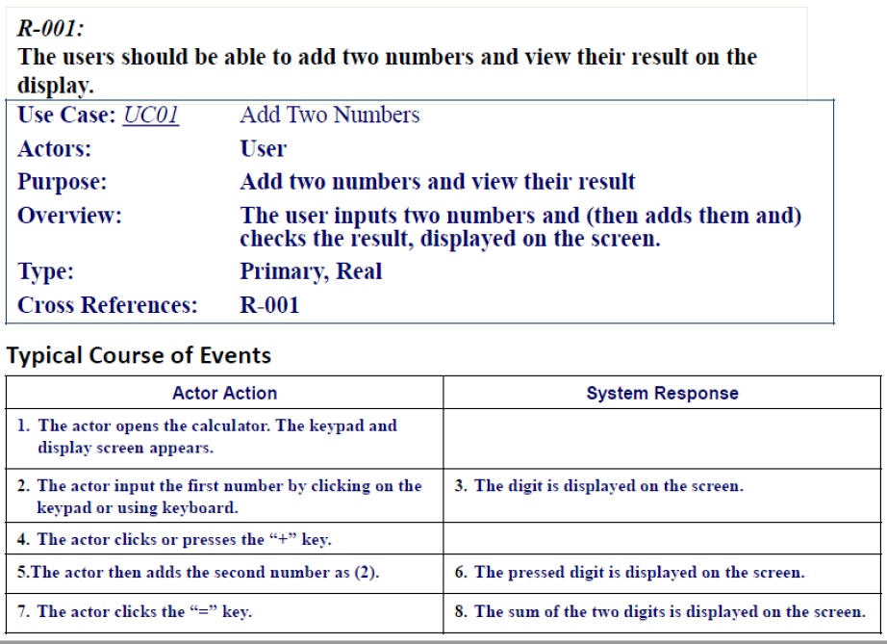
USE CASE FOR ADDING NUMBERS

Slide 18
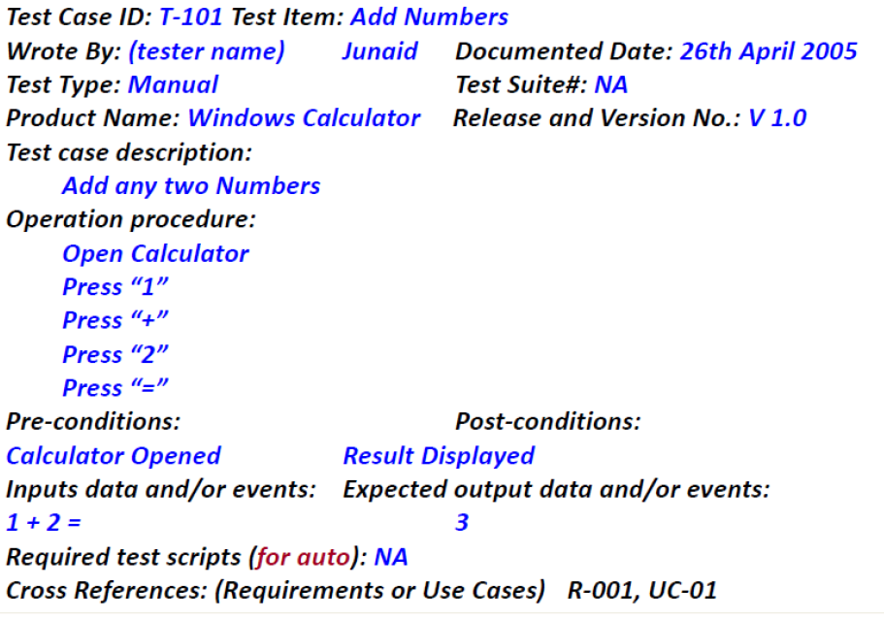
Test CASE FOR ADDING NUMBERS

Slide 19
Testing Strategies
SW testing is one element of a broader topic referred to as V&V (many SQA activities).
Verification (correctly implement specific function)
Defect detection and correction
Comparison between implementation and the corresponding specification
Are we building the product right?
Validation (SW is traceable to customer requirements)
Defect prevention
Provision of sound basis for specific design decisions
Are we building the right product?
Example: Checking the printing of receipts is verification and correct printing (info) is validation.
Notes:
Lec 34 [2018]

Slide 20
Types/Strategies of testing
Code Inspections
Software (Module) Testing
Unit Testing
Functional Testing
Integration Testing
Compliance
Interoperability Testing
System Testing
Recovery
Security
Environment
Acceptance Testing and Release Testing
Regression Testing
Stress, Security, performance, Load Testing etc

Slide 21
Software Testing
A better definition: ”the process of running software with the intent of finding an error”.
The way most testing works is to input a set of values, then compare the expected result with the out comes/computed ones.
Depending on the type of data input, we can identify three levels of program correctness possible, probable, and absolute correctness.

Slide 22
Three Levels of Correctness
Possible correctness
Obtaining correct output for some arbitrary input (single set).
If the outcome is wrong, the program cannot possibly be correct.
For example a multiply program: for input 2 and 3, if result is 6; is possibly correct.

Slide 23
Three Levels of Correctness
Probable correctness
Obtaining correct output for a number of carefully selected inputs.
If all potential problematic areas are checked in this way, the program is probably correct.
Try several values, including the obvious “problem” values such as zero, largest negative, 1, -1 and so on.

Slide 24
Three Levels of Correctness
Absolute correctness
can be demonstrated only by a test that involves every possible combination of inputs.
Requires huge amount of time; it is therefore not practical {However for some programs we can prove correctness mathematically}.
Imagine the same above test for a 32 bit machine (how many combinations are possible? (Hundreds of Millions).

Slide 25
A Small Testing Example
You are to develop a small program that reads three integer values from an input dialog. The three values represent the lengths of the sides of a triangle.
The program displays a message that states whether the triangle is scalene, isosceles, or equilateral.
Write a set of test cases—specific sets of data—to properly test the program
The set of test data must be handled by the program correctly to be considered a successful program.
Remember that
a scalene triangle is one where no two sides are equal,
whereas an isosceles triangle has two equal sides, and
an equilateral triangle has three sides of equal length.

Slide 26
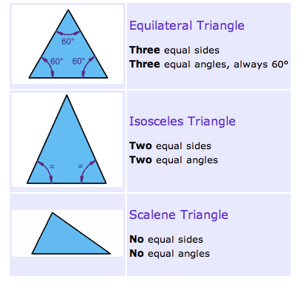
Definitions

Slide 27
int main()
{
float a,b,c;
cin>>a >> b >>c;
if(a<(b+c) && b < (a+c) && c< (a+b))
{
cout<<"\nIt is a Triangle.”;
if (a==b && b==c)
cout<<"\nIt is a Equilateral Triangle.”;
if(a==b || a==c || b==c)
cout<<"\nIt is a Isosceles Triangle.”;
else
cout<<"\nIt is a Scalene Triangle.”;
}
else
cout<<"This Triangle is not possible.”;
return 0;
}
What test cases do you think should be there?
For the input values to represent a triangle, they must be integers greater than 0 where the sum of any two is greater than the third.

Slide 28
Questions to Answer ??
Do you have a test case that represents a valid scalene triangle
Do you have a test case that represents a valid equilateral triangle?
Do you have a test case that represents a valid isosceles triangle?
Do you have at least three test cases that represent valid isosceles triangles such that you have tried all three permutations of two equal sides (such as, 3, 3, 4; 3, 4, 3; and 4, 3, 3)?
Do you have a test case in which one side has a zero value?
Do you have a test case in which one side has a negative value?
Do you have a test case with three integers greater than zero such that the sum of two of the numbers is equal to the third? (That is, if the program said that 1, 2, 3 represents a scalene triangle, it would contain a bug.)

Slide 29
Questions to Answer ?? (2)
Do you have at least three test cases in category 7 such that you have tried all three permutations where the length of one side is equal to the sum of the lengths of the other two sides (for example, 1, 2, 3; 1, 3, 2; and 3, 1, 2)?
Do you have a test case with three integers greater than zero such that the sum of two of the numbers is less than the third (such as 1, 2, 4 or 12,15,30)?
Do you have at least three test cases in category 9 such that you have tried all three permutations (for example, 1, 2, 4; 1, 4, 2; and 4, 1, 2)?
Do you have a test case in which all sides are zero (0, 0, 0)?
Do you have at least one test case specifying noninteger values (such as 2.5, 3.5, 5.5)?
Do you have at least one test case specifying the wrong number of values (two rather than three integers, for example)?
For each test case did you specify the expected output from the program in addition to the input values?

Slide 30
Testing the triangle program – Some thoughts!
A very simple program
To do exhaustive testing
Test with all possible values of a, b, & c (the three sides)
And their combinations
32-bit integer, 2³² possible values for one integer
Assuming only integers from 1 to 10, there are 10¹² possible values for a triangle.
Testing 1000 cases per second, you would need 317 years!
Test with all the invalid inputs
e.g., All strings ;)

Slide 31
Testing the triangle program – Some thoughts!
If testing a trivial program is so complex, what about testing large programs of thousands of lines of code, e.g., air traffic control software
Solution?

Slide 32
Testing the triangle program – Some thoughts!
If testing a trivial program is so complex, what about testing large programs of thousands of lines of code, e.g., air traffic control software
Solution?
Use of sophisticated testing techniques
Select the test cases that have most chances of triggering a failure
e.g, boundary values

Slide 33
Test case design
"Bugs lurk in corners
and congregate at
boundaries ..."
OBJECTIVE ---- to uncover errors
Boris Beizer
CRITERIA ----- In a complete manner
CONSTRAINT ------ with a minimum of effort and time
A successful test -- -- that uncovers an as-yet undiscovered error.
Minimum number of required tests with 100% functional coverage and 0% redundancy.
Rich variety of test case design methods
- Cause-effect graphing, Equivalence Class Partitioning, Boundary Analysis, and vendor specific: client/server, OO test case design.
Possible approaches:
(1) Knowing the specified functions, tests can be conducted to demonstrate that each function is fully operational (Black Box).
(2) Knowing the internal workings of a product, tests can be conducted to ensure that “all gears mesh“ (White Box).

Slide 34


